Slide 1
Lesson 8: Functional Dependencies &
Normalization
CSC430/530 – DATABASE MANAGEMENT SYSTEMS

Slide 2
OUTLINE
Introduction.
Informal design guidelines.
Functional dependencies.
Normalization.
First normal form (1NF).
Second normal form (2NF).
Third normal form (3NF).
Boyce-Codd normal form (BCNF).

Slide 3
INTRODUCTION
Relational database design.
Process of grouping of attributes to form “good” relation schemas.
Two levels of relational schemas:
Logical level – how user views the relations.
Physical level – how tuples are stored and updated.
Relational design is mainly focused on physical level (base relations).
The product of relational database design is a set of base relations.
Relational design has two implicit goals:
Information preservation.
Capturing all the concepts from EER design.
Minimizing redundancy.
Reducing redundant storage of the same information and the need for multiple updates.

Slide 4
INFORMAL DESIGN GUIDELINES: OVERVIEW
Informal design guidelines that determine the quality of the relation schema design:
Making sure that the semantics of the attributes is clear in the schema;
Reducing the redundant information in tuples;
Reducing the NULL values in tuples;
Disallowing the possibility of generating spurious tuples.

Slide 5
INFORMAL DESIGN GUIDELINES (1)
GUIDELINE 1: Each tuple in a relation should represent one entity or relationship instance.
Attributes of different entities should not be mixed in the same relation.
Only foreign keys should be used to refer to other entities.
Design schema that can be explained easily relation by relation.
The semantics of attributes should be easy to interpret.

Slide 6
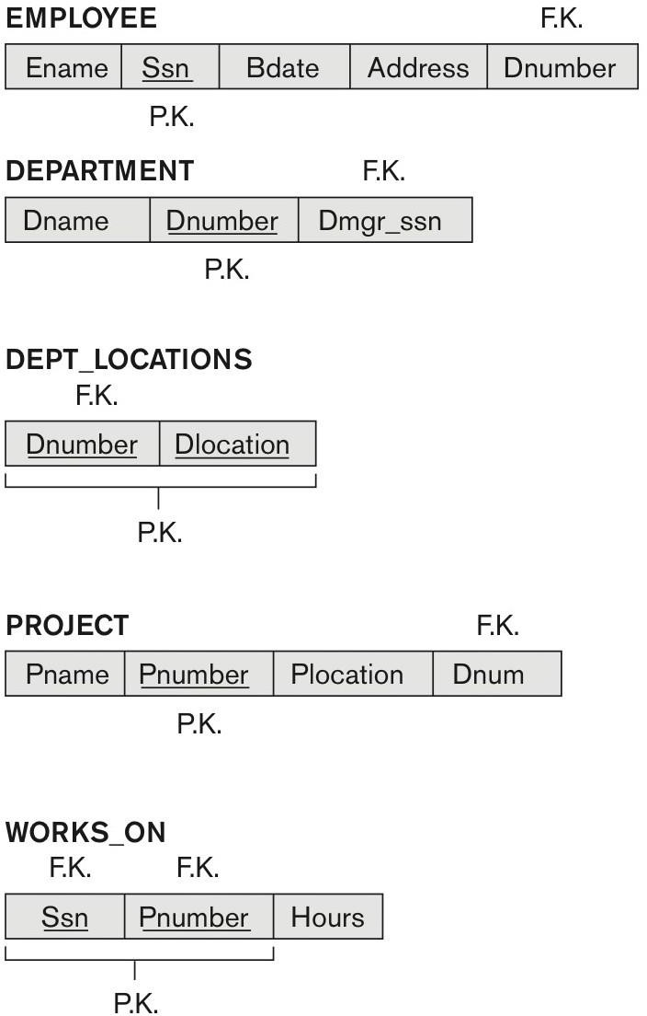
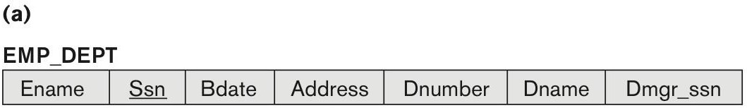
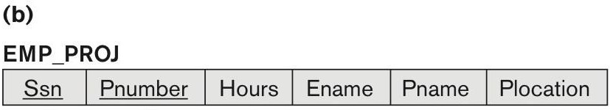
INFORMAL DESIGN GUIDELINES (1)
Modified COMPANY relational schema
Simplified COMPANY relational schema

Slide 7
INFORMAL DESIGN GUIDELINES (2)
GUIDELINE 2: Schema should not contain redundant information and must not suffer from the
insertion, deletion and update anomalies.
If information stored redundantly:
Wastes storage space.
Causes update anomalies.
Insertion anomalies.
Deletion anomalies.
Modification anomalies.
EMP_DEPT and EMP_PROJ relations

Slide 8
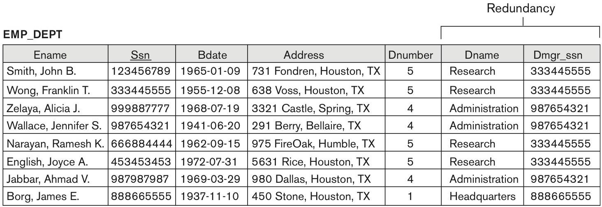
INFORMAL DESIGN GUIDELINES (2)
Example of a redundancy in EMP_DEPT relation

Slide 9
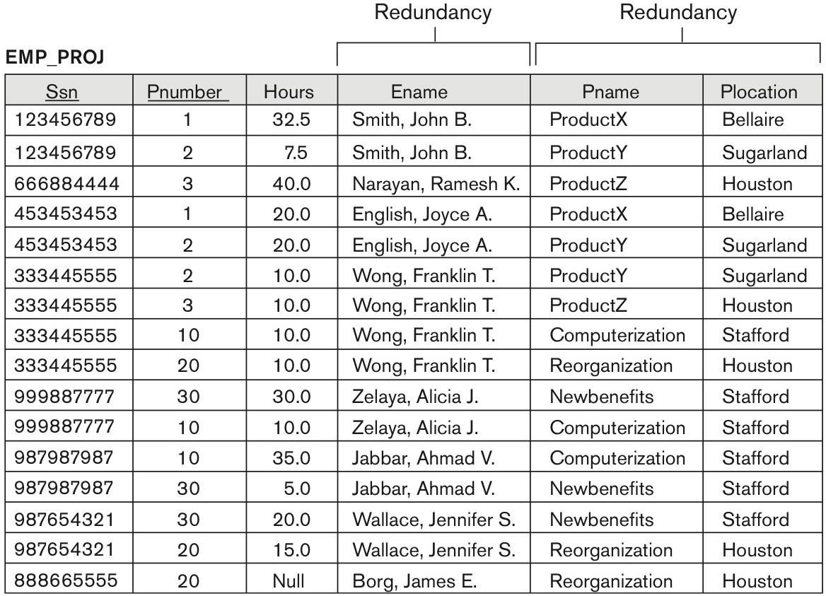
INFORMAL DESIGN GUIDELINES (2)
Example of a redundancy in EMP_PROJ relation

Slide 10
INFORMAL DESIGN GUIDELINES (3)
GUIDELINE 3: Relations should be designed such that their tuples have as few NULL values as
possible.
If NULLs are unavoidable, make sure that they apply in exceptional cases only and do not apply to a
majority of tuples in the relation.
Negative effects of NULL values:
Waste of space.
Harder to understand the meaning of an attribute.
Harder to apply JOINs and aggregate functions (COUNT, SUM).

Slide 11
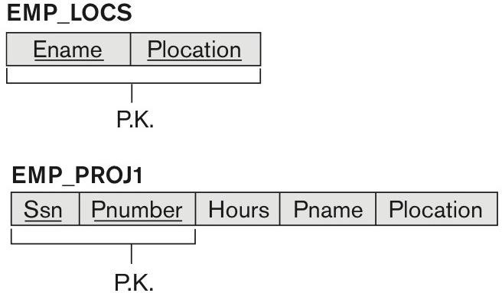

INFORMAL DESIGN GUIDELINES (4)
GUIDELINE 4: Relation schemas should only be able to be joined with equality conditions on
attributes that are appropriately related pairs (foreign key – primary key).
This guarantees that no spurious tuples are generated.
Joining relations that contain matching attributes that are not “foreign key - primary key”
combinations may produce spurious tuples.
EMP_PROJ relation broken down into EMP_LOCS and EMP_PROJ1 relations

Slide 12
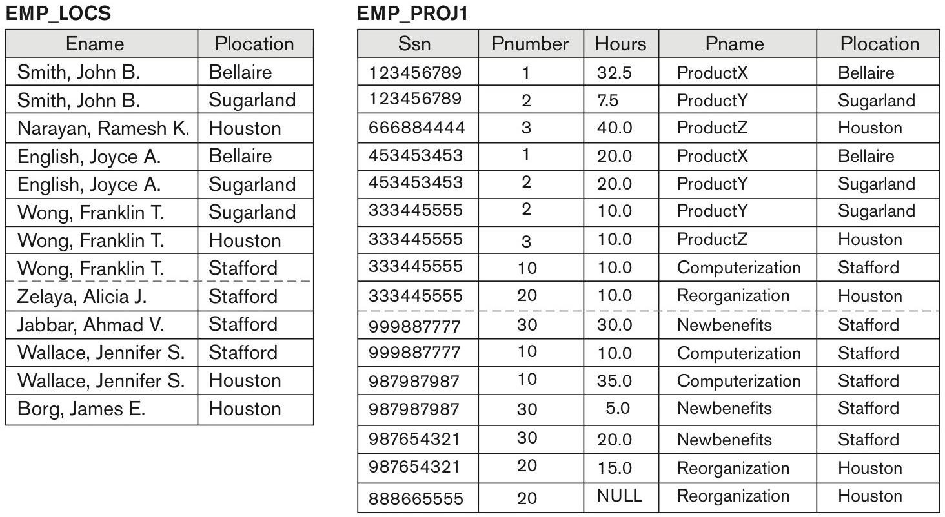
INFORMAL DESIGN GUIDELINES (4)
State of EMP_LOCS and EMP_PROJ1 relations

Slide 13
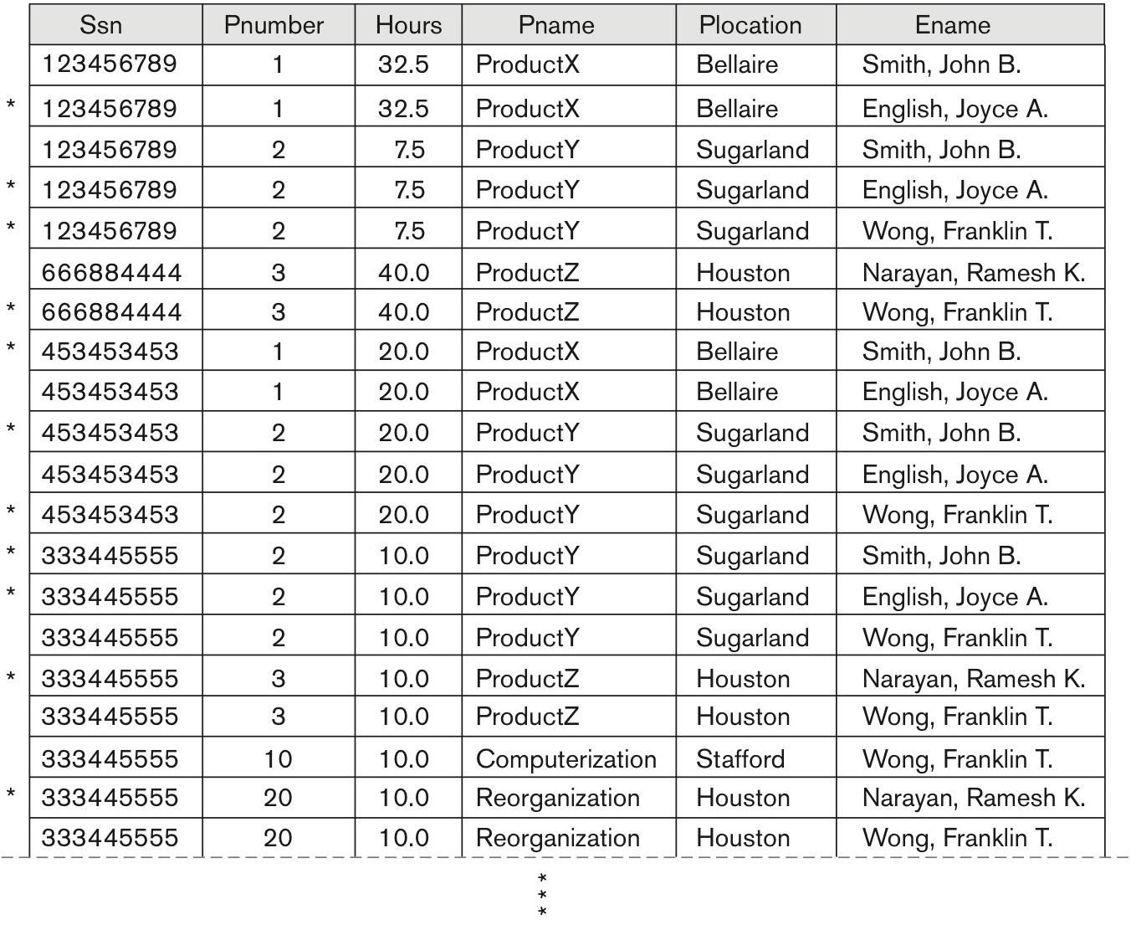
INFORMAL DESIGN GUIDELINES (4)
Spurious tuples when joining EMP_LOCS and EMP_PROJ1 relations

Slide 14
FUNCTIONAL DEPENDENCIES (1)
Functional dependencies (FDs) are used to specify formal measures of “goodness” of the
database design.
FD is a constraint between two sets of data attributes, derived from real-world constrains (semantic) on these attributes.
FD is written as X -> Y.
X - left-hand-side (LHS).
Y - right-hand-side (RHS).
A set of attributes X functionally determines a set of attributes Y if the value of X determines
a unique value for Y.
X -> Y holds if whenever two tuples have the same value for X, they must have the same value for Y.
If t₁[X] = t₂[X], then t₁[Y] = t₂[Y].

Slide 15
FUNCTIONAL DEPENDENCIES (2)
FD constraint is a property of the relation schema and cannot be inferred automatically from a
particular relation state.
FD constraint must hold on every relation state.
If set of attribute K is a key of relation R, then K functionally determines all attributes in R.
Since there are no two distinct tuples with t₁[K]=t₂[K].

Slide 16
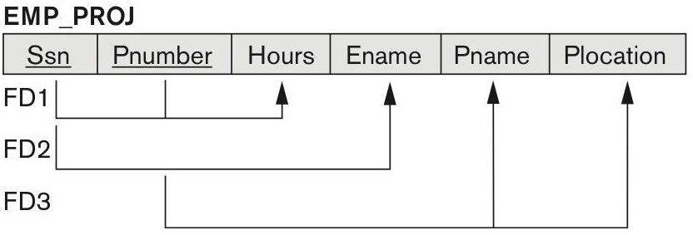
FUNCTIONAL DEPENDENCIES: EXAMPLES (1)
Examples of possible FDs from EMP_PROJ relation:
Ssn -> Ename
The value of an employee’s social security number (Ssn) uniquely determines the employee name (Ename).
Pnumber -> {Pname, Plocation}
The value of a project’s number (Pnumber) uniquely determines the project name (Pname) and location (Plocation).
{SSN, Pnumber} -> Hours
Combination of social security number (Ssn) and project number (Pnumber) values uniquely determines the
number of hours the employee currently works on the project per week (Hours).
FD is displayed as a horizontal line, LHS is a vertical line,
RHS is a vertical line with arrow.

Slide 17
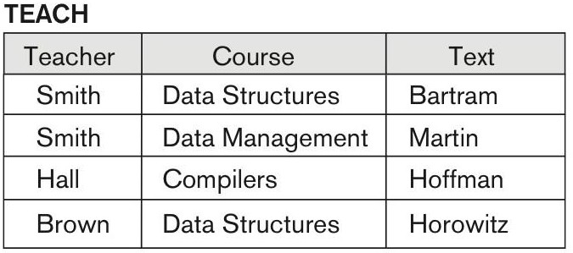
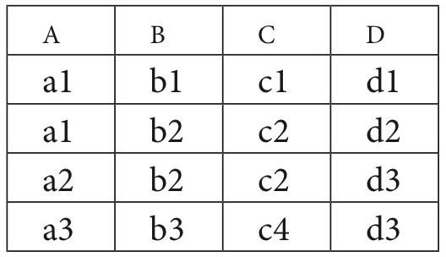
FUNCTIONAL DEPENDENCIES: EXAMPLES (2)
Specify possible FD(s) for following relation:
FDs that may hold:
Text -> Teacher
Text -> Course
FDs that are violated:
Teacher -> Course
Teacher -> Text
Course -> Text
Course -> Teacher

Slide 18
NORMALIZATION (1)
Normalization (of a relation) – top-down process that evaluates relation against the criteria
for normal forms and decomposes relation as necessary.
Relation design by analysis.
Four main normal forms:
First normal form (1NF).
Second normal form (2NF).
Third normal form (3NF).
Boyce-Codd normal form (BCNF).
Stricter form of 3NF.
Two additional NF (not used in practice):
Forth normal form (4NF).
Fifth normal form (5NF).
All NFs are based on functional dependencies among the attributes of the relation & their PKs.

Slide 19
NORMALIZATION (2)
Goals of the normalization process:
Minimize redundancy.
Minimize the insertion, deletion, and update anomalies.
Normalization process insures that the relational schema complies with two properties:
Non-additive join (lossless join) property.
No spurious tuples are generated after decomposition.
Dependency preservation property.
Each FD is represented in some relation after decomposition.

Slide 20
DEFINITION OF KEYS (REVIEW)
Superkey.
Set of attributes with the property that no two tuples in any relation state have same values.
Key.
Minimal superkey – If we remove an attribute from key it would no longer be a superkey.
Candidate key(s).
If more then one key in a relation, then each is a candidate key.
Primary key.
One of the candidate keys that is arbitrarily designated to be primary.
Prime attribute.
Attribute that is a member of some candidate key.
Non-prime attribute.
Attribute that is not a member of any candidate key.

Slide 21
FIRST NORMAL FORM (1NF)
First normal form (1NF) informal definition.
No multivalued or composite attributes and their combinations are allowed.
First normal form (1NF) formal definition.
Domains of the attributes must include only atomic (simple, indivisible) values and every value must
be a single value.
No sets of values, tuples of values, or combinations.
No relations within relation or relations as attribute values within tuples.

Slide 22
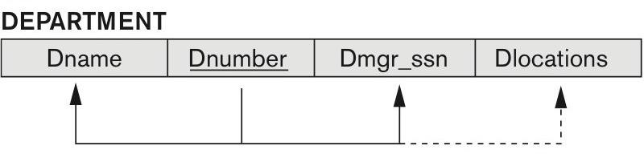
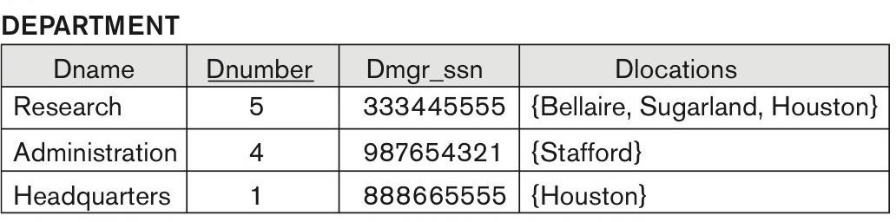
FIRST NORMAL FORM: EXAMPLE (1)
DEPARTMENT relation is not in 1NF, since Dlocation attributes is not atomic (multivalued).
Three ways to normalize DEPARTMENT into 1NF:
Remove Dlocation attribute and place it in a separate relation DEPT_LOCATIONS.
Propagate PK from DEPARTMENT, thus PK of DEPT_LOCATIONS is {Dnumber, Dlocation}.
Expand the PK of DEPARTMENT to be {Dnumber, Dlocation}.
Disadvantage – redundancy.
Max # of locations known → create separate attribute for each location.
Dlocation1, Dlocation2, Dlocation3 …
Disadvantages – NULL values & harder to write queries.

Slide 23
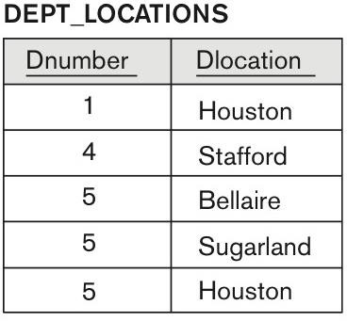
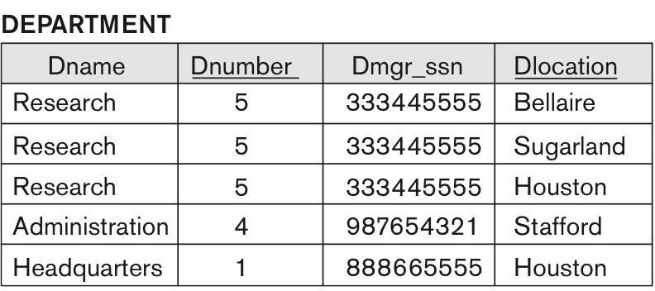
FIRST NORMAL FORM: EXAMPLE (1)
Solution 1 (recommended): •Solution 2 (redundant):

Slide 24
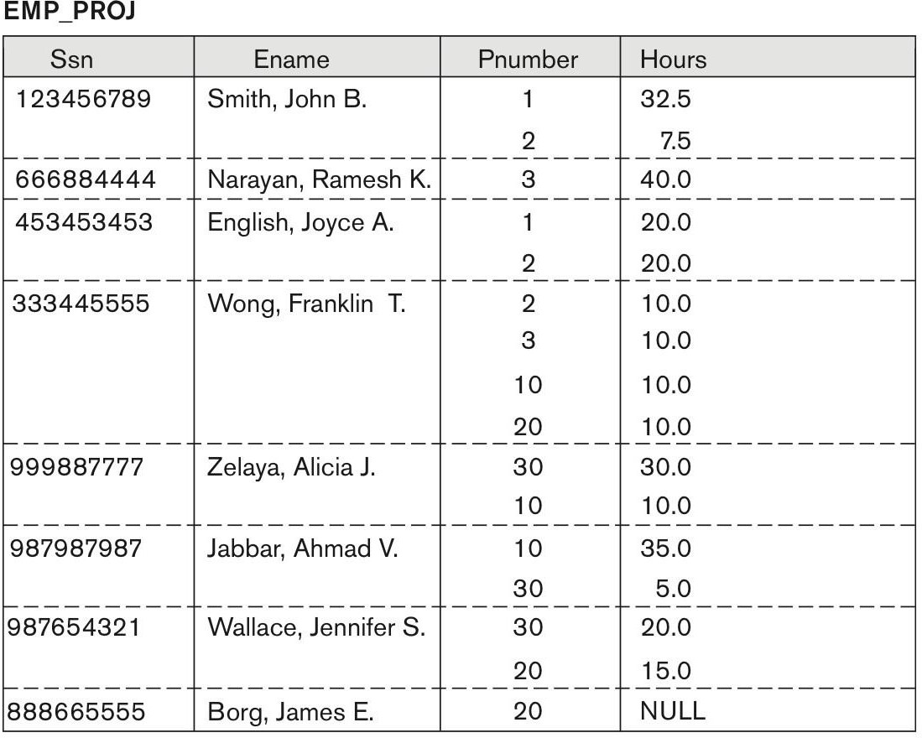
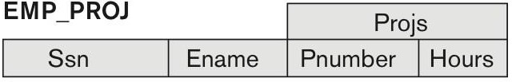


FIRST NORMAL FORM: EXAMPLE (2)
EMP_PROJ relation is not in 1NF.
EMP_PROJ is a nested relation.
Each tuple is an employee entity with a relation PROJS(Pnumber, Hours) as an attribute.
Normalized into 1NF by removing nested relation attribute into separate relation and propagating PK of EMP_PROJ relation.

Slide 25
SECOND NORMAL FORM (2NF)
Second normal form (2NF) formal definition.
Relation is in 2NF if every non-prime attribute is fully functionally dependent on the PK.
Full functional dependency.
FD X -> Y is full functional dependency if removing any attributes from X means dependency does
not hold anymore.
{Ssn, Pnumber} -> Hours
Neither Ssn -> Hours, nor Pnumber -> Hours holds.
Partial function dependency.
FD X -> Y is partial functional dependency if some attribute(s) can be removed from X and the dependency still holds.
{Ssn, Pnumber} -> Ename
Ssn -> Ename holds.

Slide 26
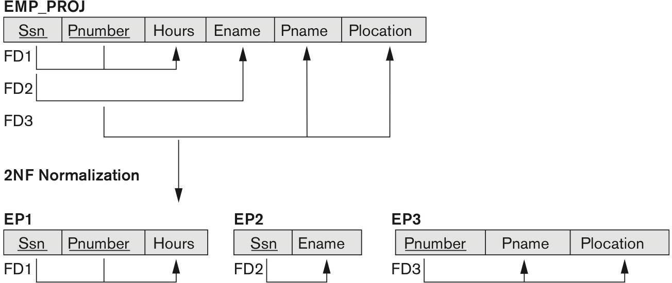
SECOND NORMAL FORM: EXAMPLE
EMP_PROJ relation is 1NF, but not in 2NF.
Violations of 2NF:
FD2: Ename is functionally determined only by Ssn.
FD3: Pname & Plocation
by Pnumber.
Ename, Pname & Plocation (non-prime attributes) partially
functionally dependent on {Ssn, Pnumber} PK.
Both FD2 & FD3 violate 2NF.
is functionally determined only
Normalizing EMP_PROJ into 2NF:
Decompose relation into 2NF relations where non-prime attributes are associated only with the part of the PK on which they are fully functionally dependent.

Slide 27
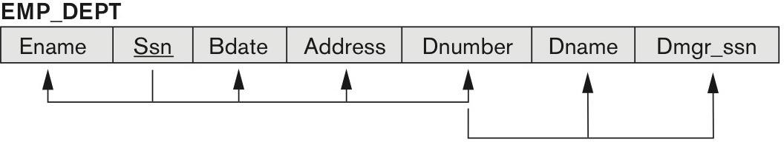
THIRD NORMAL FORM (3NF)
Third normal form (3NF) formal definition.
Relation is in 3NF if it is in 2NF and no non-prime attribute(s) is transitively dependent on the PK.
Transitive dependency.
FD X -> Y is transitive dependency if there exists set of attributes Z that is neither a candidate key
nor a subset of any keys, and both X -> Z and Z -> Y hold.
Example:
Ssn -> Dmgr_ssn and Ssn -> Dname are transitive through Dnumber.
Ssn -> Dnumber and Dnumber -> Dmgr_ssn hold.
Ssn -> Dnumber and Dnumber -> Dname hold.
Dnumber is not a key and not a subset of a key.

Slide 28
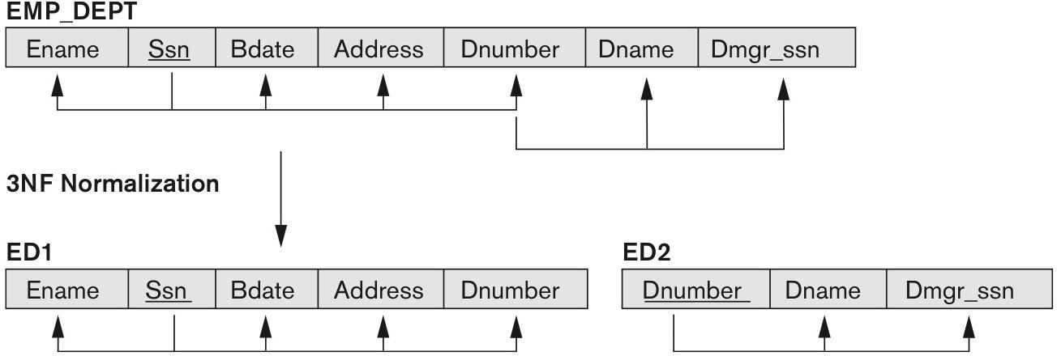
THIRD NORMAL FORM: EXAMPLE
EMP_DEPT is in 2NF, but not in 3NF.
3NF is violated by transitive dependencies.
Dmgr_ssn & Dname are transitively dependent on Ssn through Dnumber.
Normalizing EMP_DEPT into 3NF:
Decompose relation into 3NF relations where no transitive dependencies exist.
ED1 and ED2 represent independent facts about employees & departments, both of which are entities on their own.
By applying natural join on ED1 and ED2 we can recover original EMP_DEPT with no spurious tuples.

Slide 29
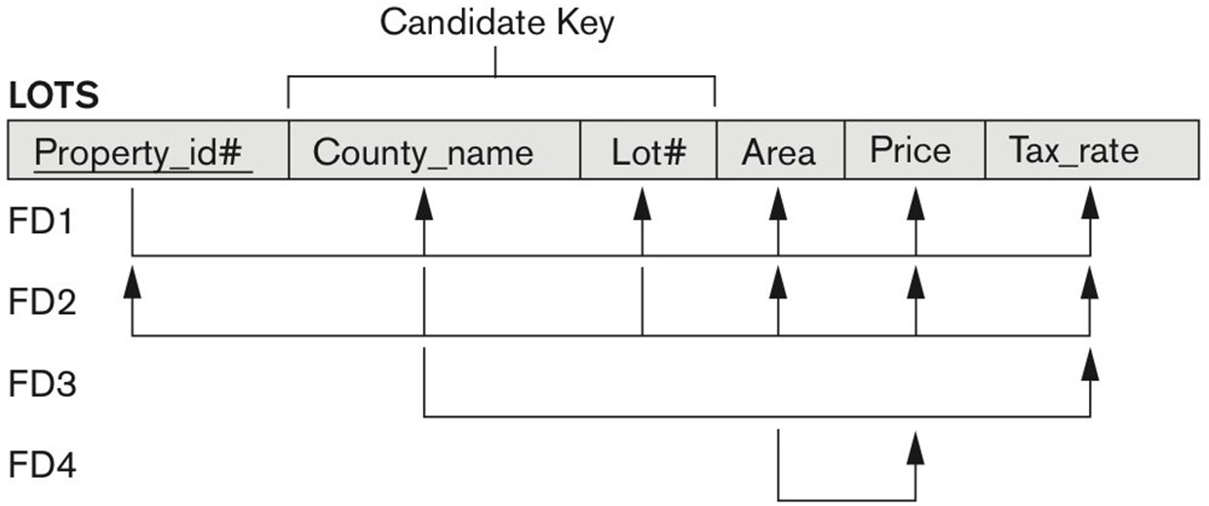
NORMALIZATION EXAMPLE (1)
LOTS relation describes land for sale in various counties of a state.
Candidate keys:
Property_id# (chosen as primary).
Property id numbers are unique across counties.
{County_name, Lot#}
Lot number is unique only within county.
FDs:
FD1 and FD2 are based on candidate keys.
FD3: County_name -> Tax_rate
Tax rate is fixed for a given county.
FD4: Area -> Price
Price of a lot is determined by the area regardless of which county it is.
What is the highest NF of this relation?

Slide 30
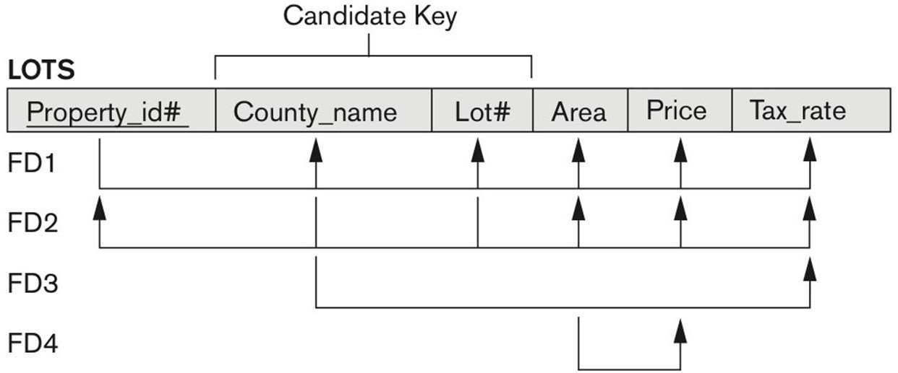
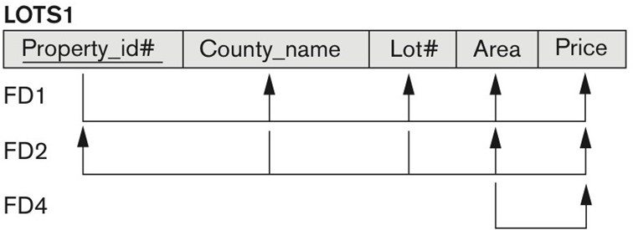
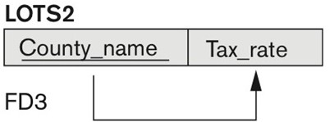
NORMALIZATION EXAMPLE (2)
FD3: County_name -> Tax_rate violates 2NF.
Tax_rate is partially dependent on the candidate key {County_name, Lot#}.
To normalize LOTS into 2NF:
Decompose it into LOTS1 and LOTS2.
LOTS1 is constructed by removing Tax_rate attribute.
LOTS2 is constructed as a FD3.
LHS of FD3 (Country_name) becomes a PK.
RHS of FD3 (Tax_rate) becomes a non-prime attribute.

Slide 31
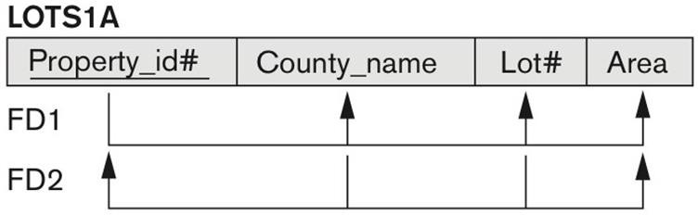
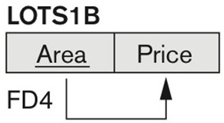
NORMALIZATION EXAMPLE (3)
FD4 in LOTS1: Area -> Price violates 3NF.
Price is transitively dependent on each of the candidate keys of LOTS1 through non-prime attribute Area.
To normalize LOTS1 into 3NF:
Decompose it into LOTS1A and LOTS1B.
LOTS1A is constructed by removing Price attribute.
LOTS1B is constructed as a FD4.
LHS of FD4 (Area) becomes a PK.
RHS of FD4 (Price) becomes a non-prime attribute.

Slide 32
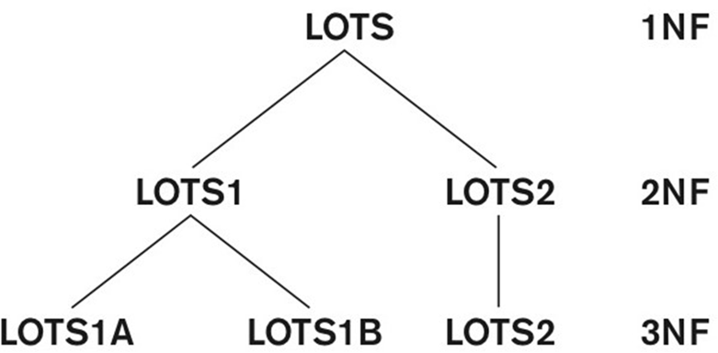
NORMALIZATION EXAMPLE (4)

Slide 33
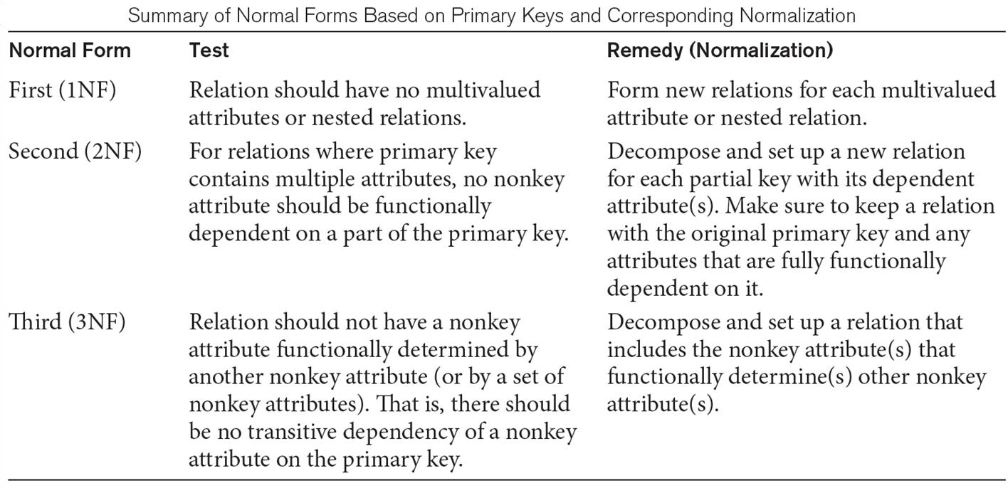
NORMAL FORMS SUMMARY

Slide 34
THIRD NORMAL FORM: GENERAL DEFINITION
Third normal form general definition (based on multiple candidate keys):
Relation schema R is in 3NF if whenever a FD X -> A holds in R, then either:
X is a superkey of R, or
A is a prime attribute of R.
Third normal form alternative definition:
Relation schema R is in 3NF if every nonprime attribute of R meets following conditions:
It is fully functionally dependent on every key of R.
It is non-transitively dependent on every key of R.
FD3 and FD4 violate 3NF general definition

Slide 35
BOYCE-CODD NORMAL FORM (BCNF)
Boyce-Codd normal form (BCNF) definition:
Relation schema R is in BCNF if whenever a FD X -> A holds in R, then X is a superkey of R.
Each normal form is strictly stronger than the previous one:
Every 2NF relation is in 1NF.
Every 3NF relation is in 2NF.
Every BCNF relation is in 3NF.
The goal of normalization process is to decompose each relation into BCNF (or 3NF).

Slide 36
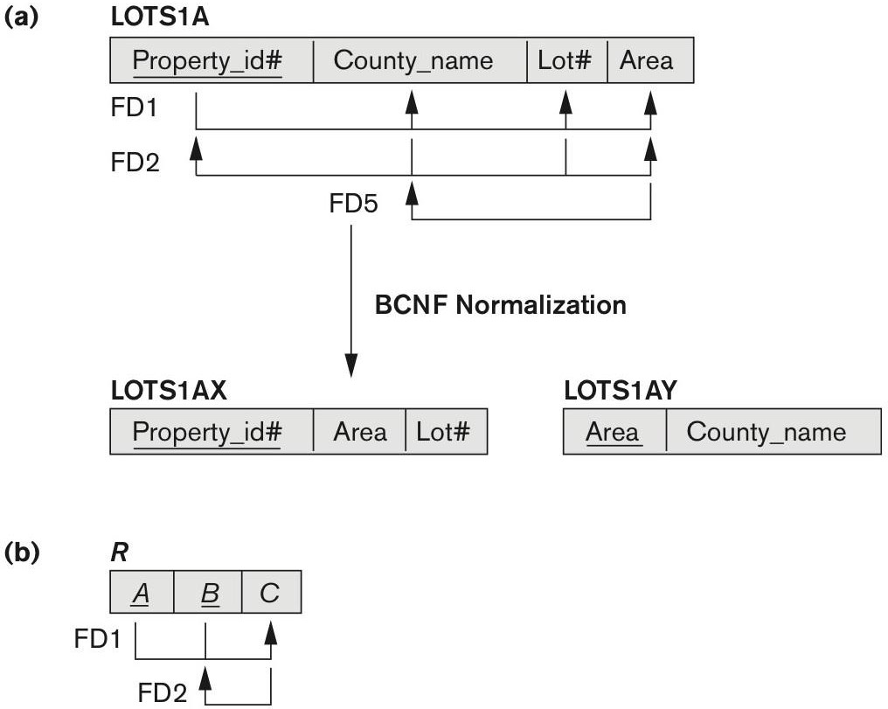
BOYCE-CODD NORMAL FORM: EXAMPLE (1)
Example (a):
FD5 is added to LOTS1A relation.
FD5: Area -> County_name.
Relation LOTS1A is in 3NF, but not in BCNF.
Area is not superkey of LOTS1A.
Relation LOTS1A is decomposed into two:
LOTS1AX & LOTS1AY.
Both in BCNF.
Example (b):
General case of relation in 3NF, but not in BCNF.
LOTS1A relation is in 3NF, but not in BCNF

Slide 37

BOYCE-CODD NORMAL FORM: EXAMPLE (2)
Relation TEACH has two FDs:
FD1: {Student, Course} -> Instructor
FD2: Instructor -> Course
{Student, Course} is a candidate key.
Relation TEACH is in 3NF, but not BCNF. Why?
Three alternative decompositions of TEACH:
R1(Student, Instructor) & R2(Student, Course).
R1(Course, Instructor) & R2(Course, Student).
R1(Instructor, Course) & R2(Instructor, Student).
Third alternative is more favorable, since it preserves non-additive join property.
No spurious tuples are generated.
TEACH relation is in 3NF, but not in BCNF

Slide 38
SUMMARY
Informal relation database design guidelines.
Functional dependencies.
Normalization process.
Normal forms and decomposition.
First normal from.
Second normal form
Third normal form.
Boyce-Codd normal form.

